Slide 1
Market Analysis in Banking Domain

Slide 2
Analysis tasks to be done-:
The data size is huge and the marketing team has asked you to perform the below analysis-
Load data and create a Spark data frame
Give marketing success rate (No. of people subscribed / total no. of entries)
Give marketing failure rate
Give the maximum, mean, and minimum age of the average targeted customer
Check the quality of customers by checking average balance, median balance of customers
Check if age matters in marketing subscription for deposit
Check if marital status mattered for a subscription to deposit
Check if age and marital status together mattered for a subscription to deposit scheme
Do feature engineering for the bank and find the right age effect on the campaign.

Slide 3
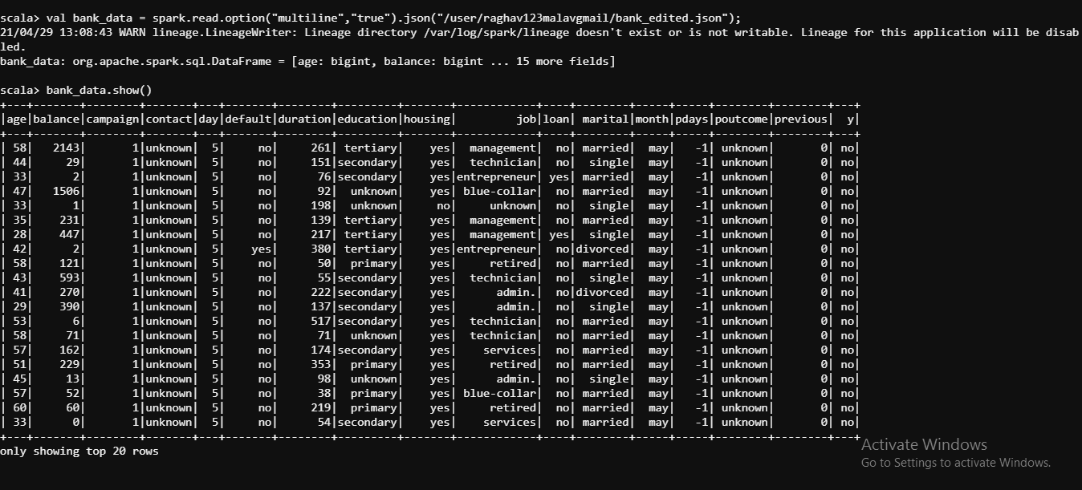
Loading Data
1)

Slide 4
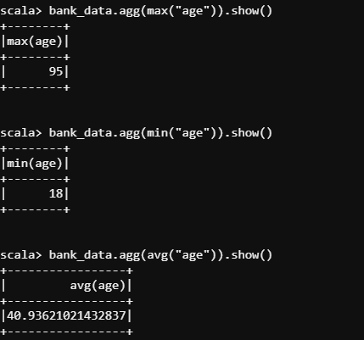
Max,Min,Mean Age
2)

Slide 5
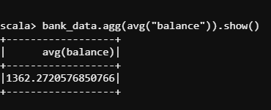
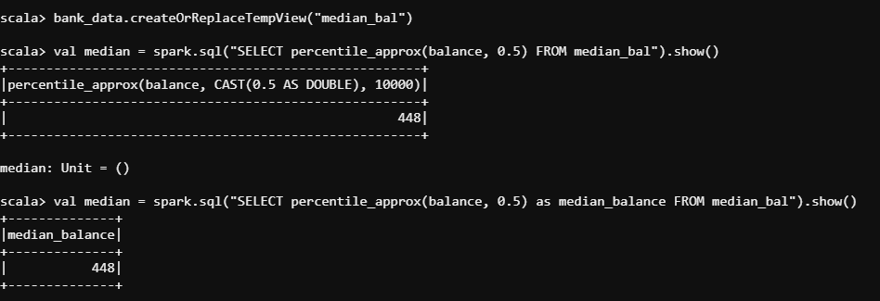
Avg and Median Balance
3)

Slide 6
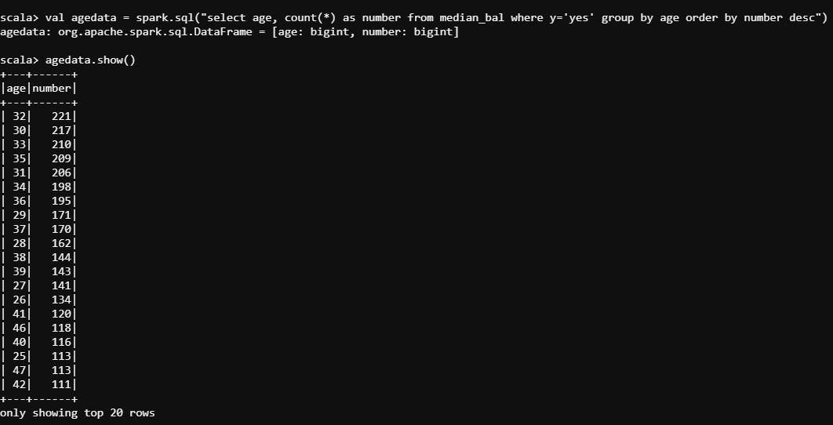
Age in Deposits
4)

Slide 7
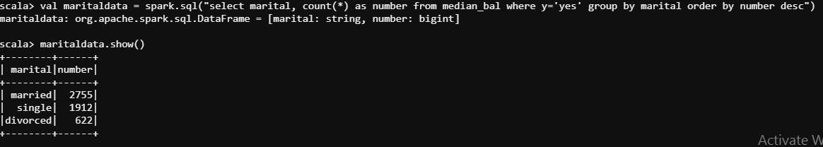
Marital Status in Deposits
5

Slide 8
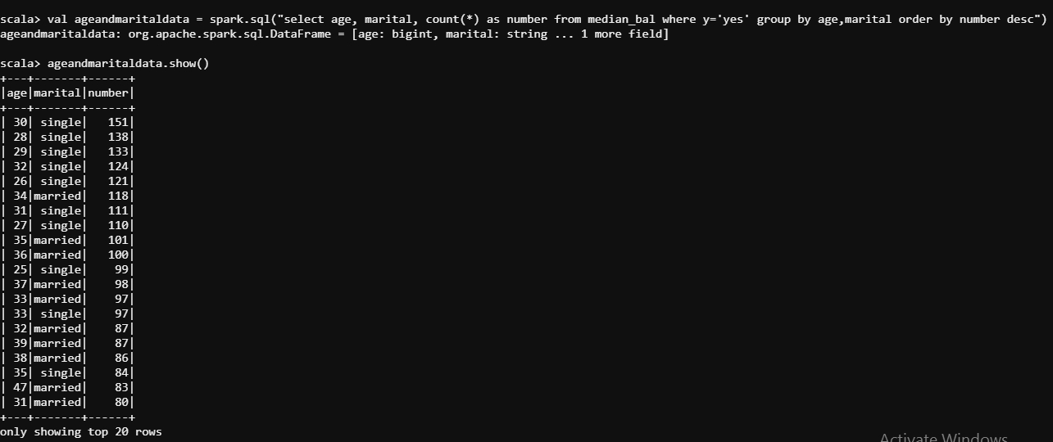
Age and Marital Status in Deposits
6)

Slide 9
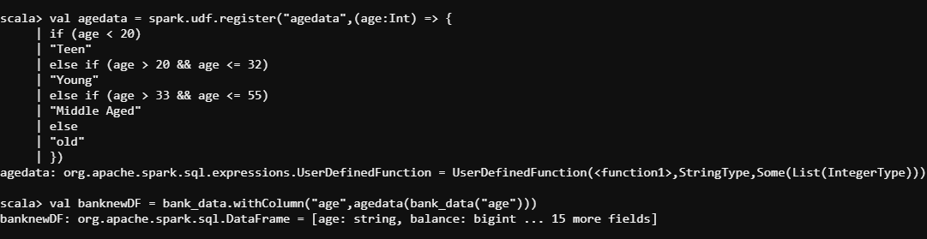
Feature Engineering
7)a)

Slide 10
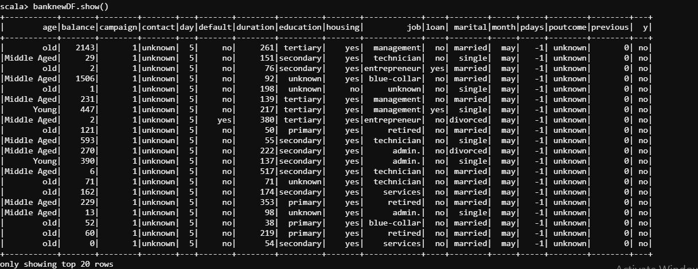
Feature Engineering
7)b)

Slide 11
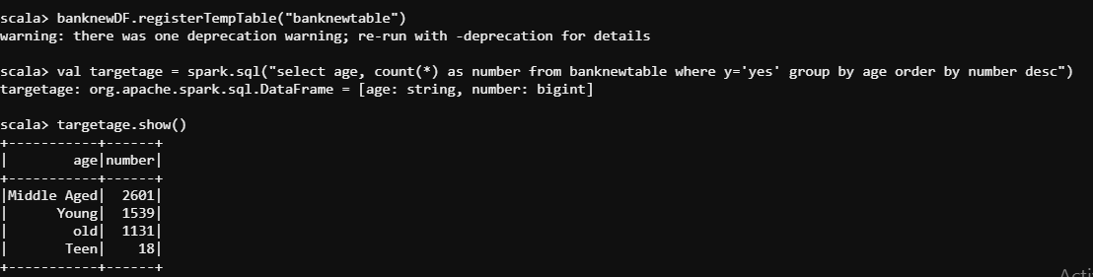
Feature Engineering
7)c)

Slide 12
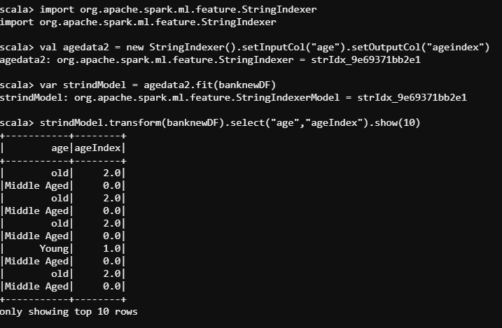
Feature Engineering
7)d)

